Slide 1
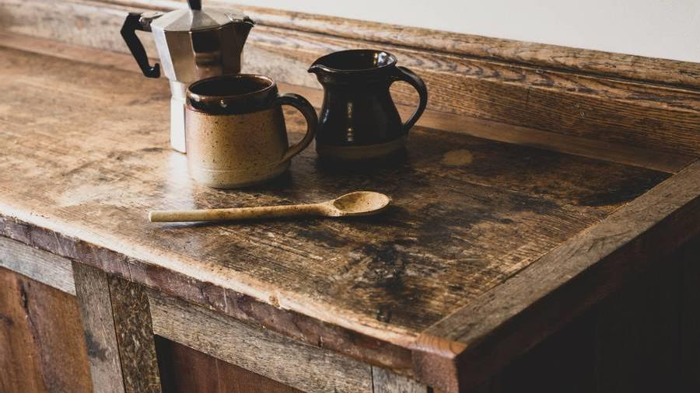
OUI and DWise
Bernardo Alves
Leader of Group D

Slide 2


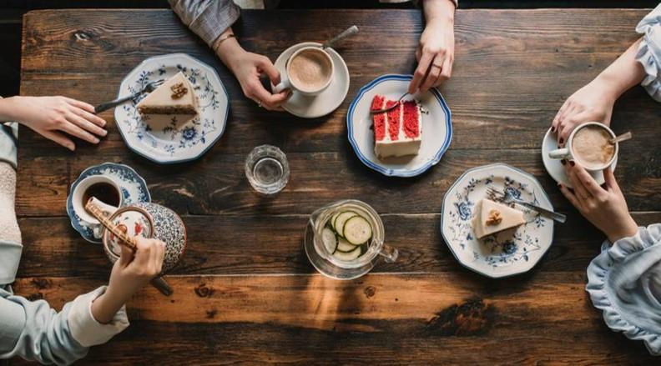
Table of content
Introduction
Main
Menu
Video
Newsletter
Phone version
Design 2

Slide 3


Introduction
OUI is a café that exists for 8 years. Aiming at the age of 18 -30.
With a French twist
Notes:
Bart Oerlemans will be your client with Gerjan van Oenen as supporting colleague.
the bar has been around for 7-8 years, started with regular style cafe.
more of a grab and to go style, not much interaction. they decided to let
go of the idea and want to change it to something for people to stay for longer.
they want to target mostly students and young adults but mostly students.
different types of coffee. not the ins and out, and display the prices some
type of menu.
students and adults are getting the same amount in price.
seperate location for adults and students to study in quiet.
they don't want to have it overly french. subtle hints of french.
focus on the new age group, find out what catches the public eye.
we can do our own thing.
Keep to the age group
Mobile devices wide screen
Talk about req

Slide 4
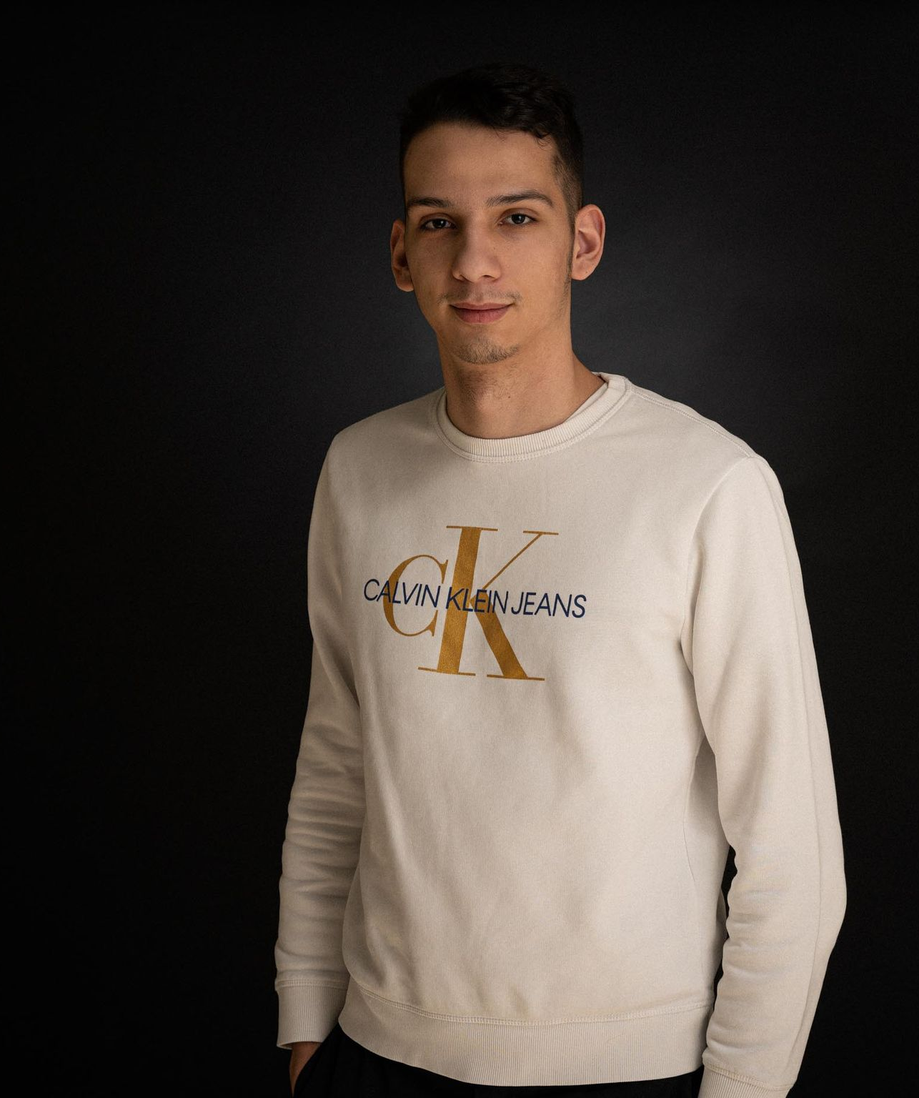
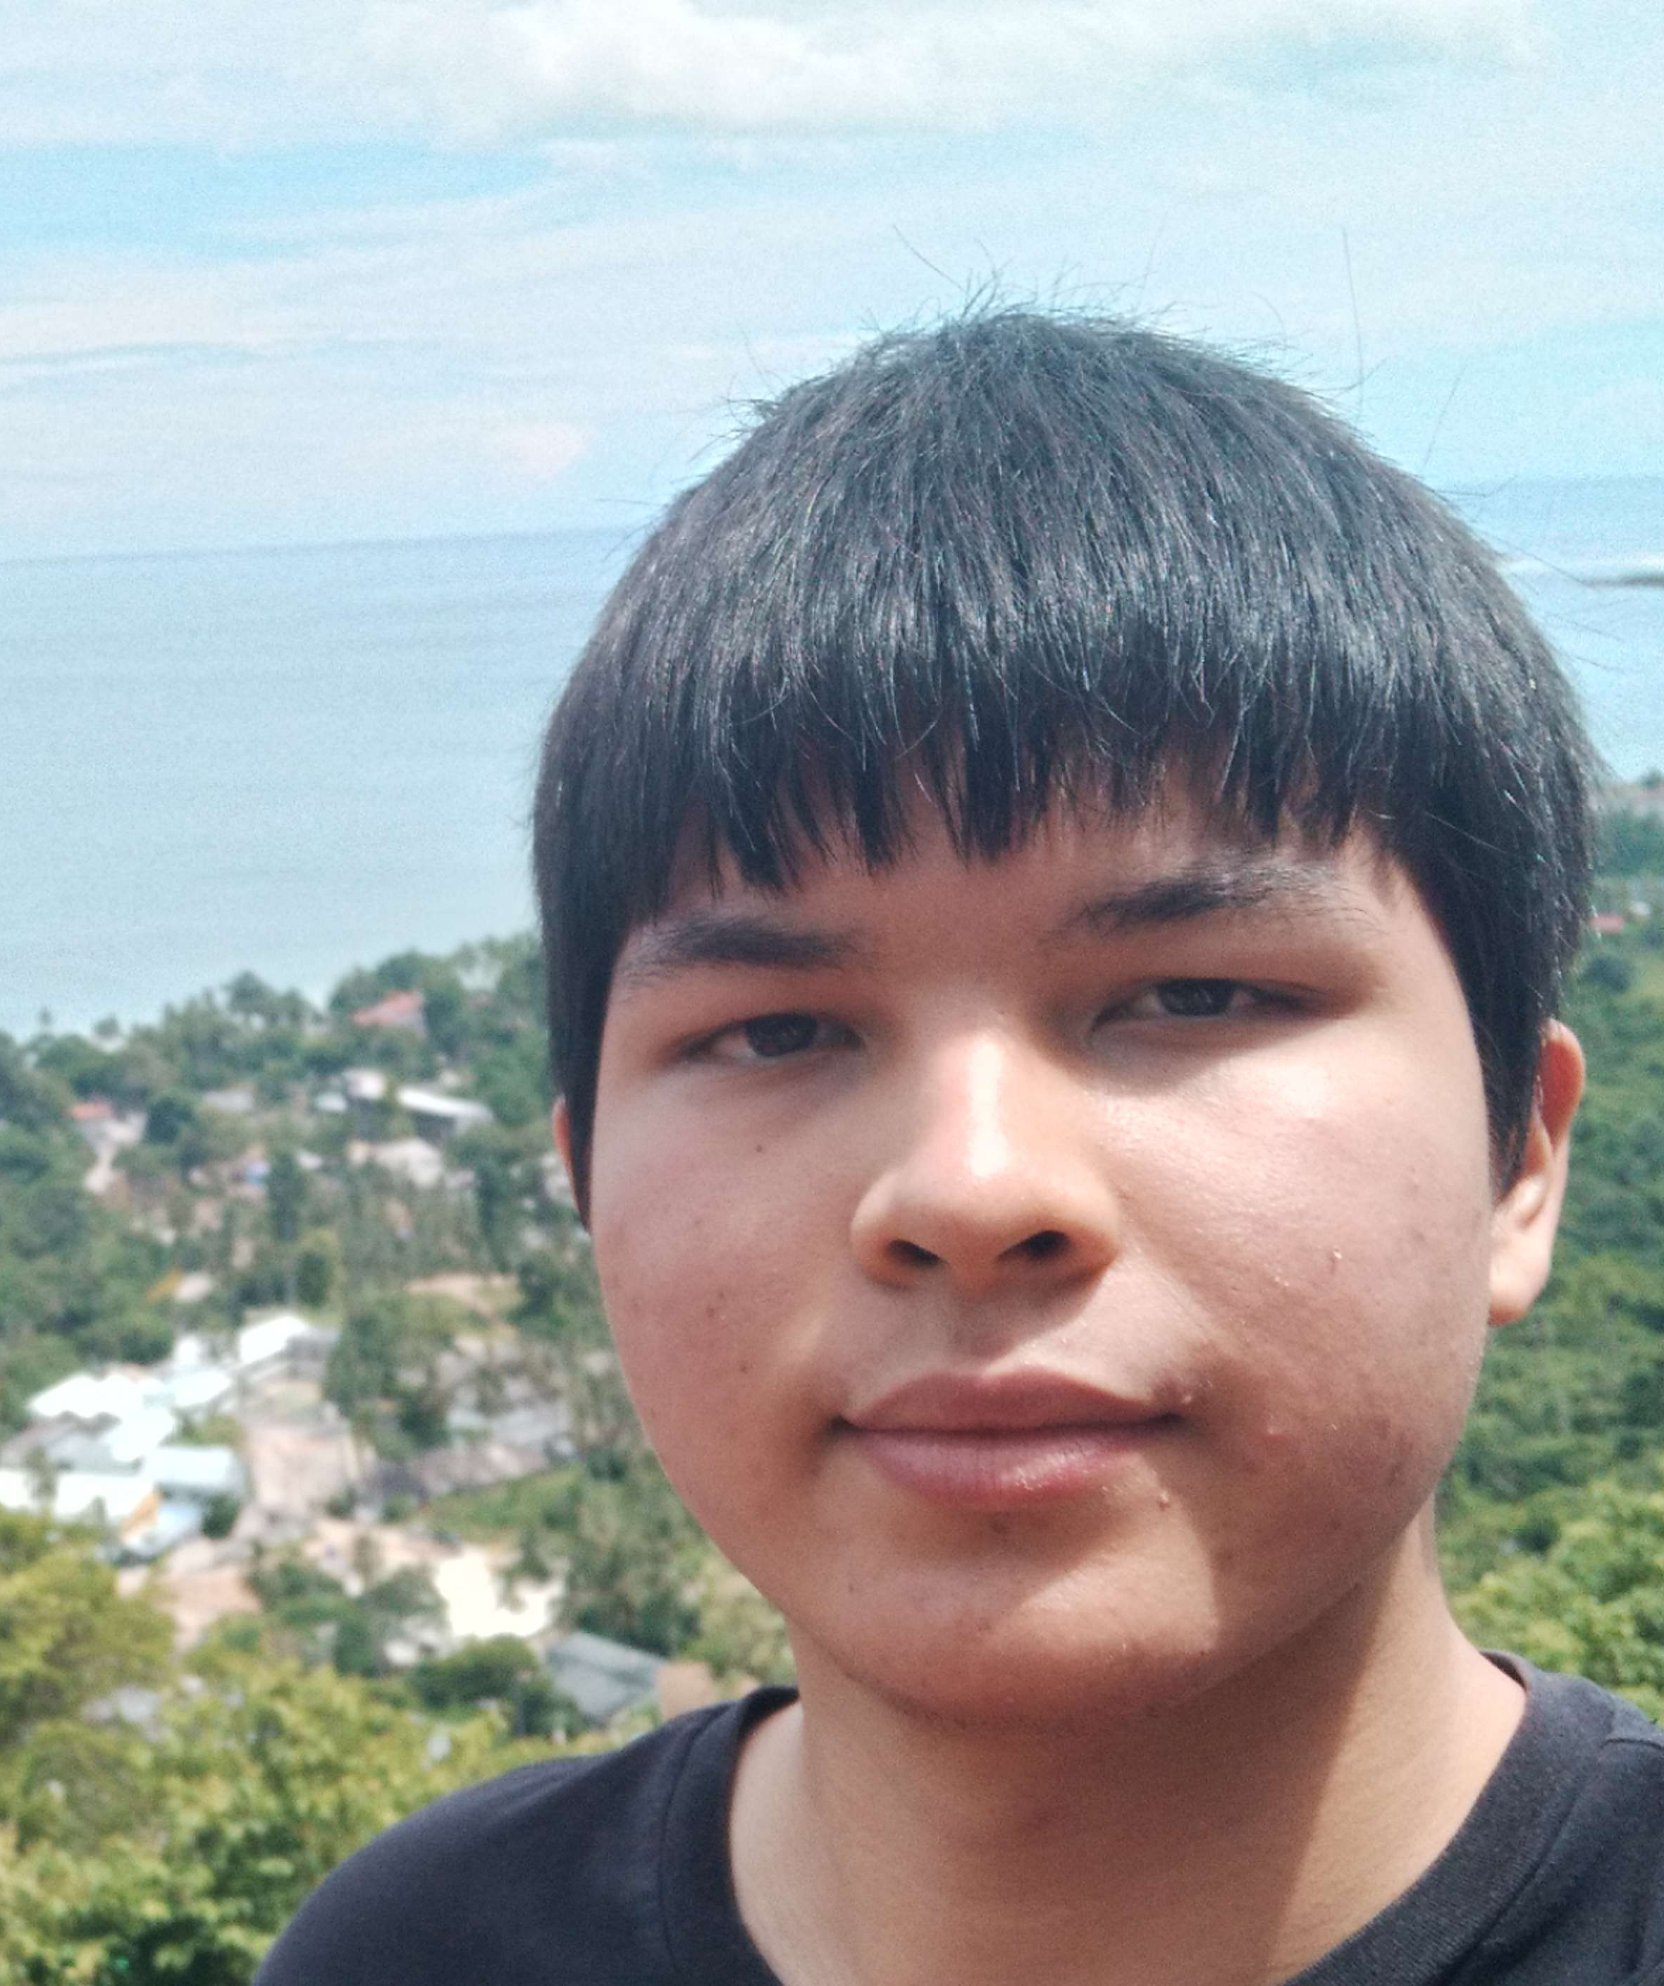
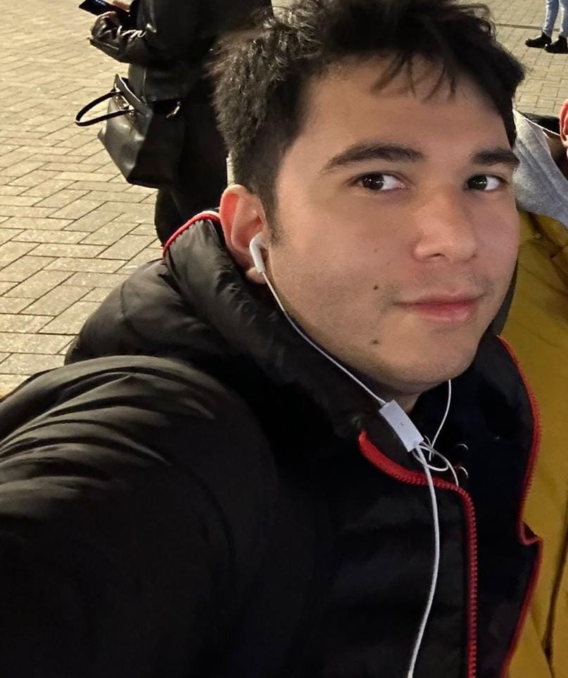
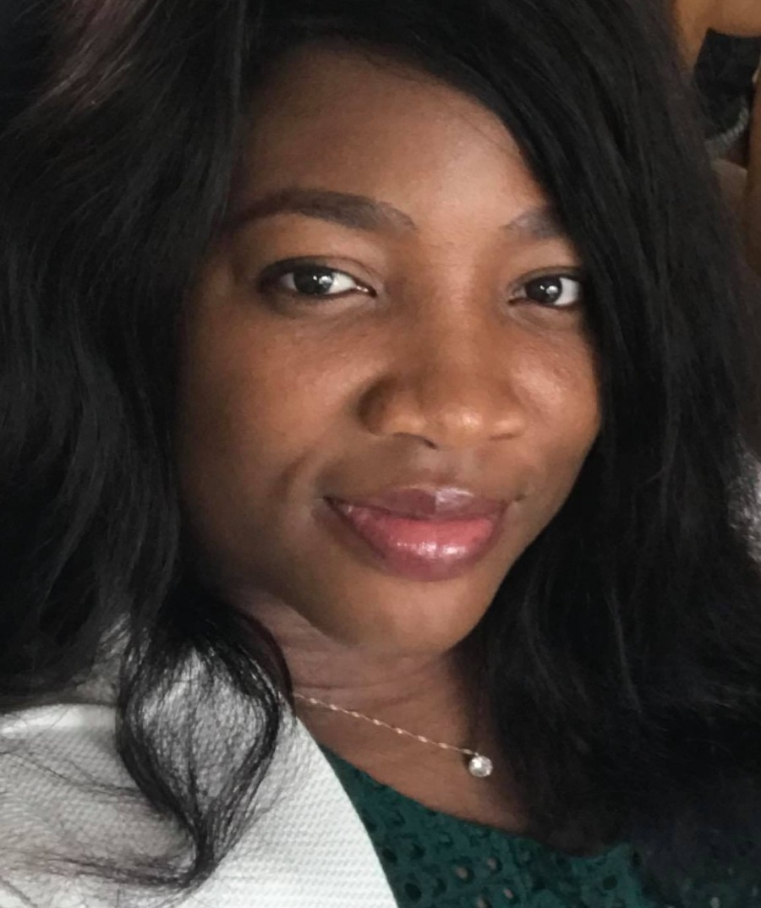
Team
Bernardo Alves
Alex Schuepbach
Gabriel Guevara
Funmy Okolie
Leader
Secretary
Employee
Employee

Slide 5
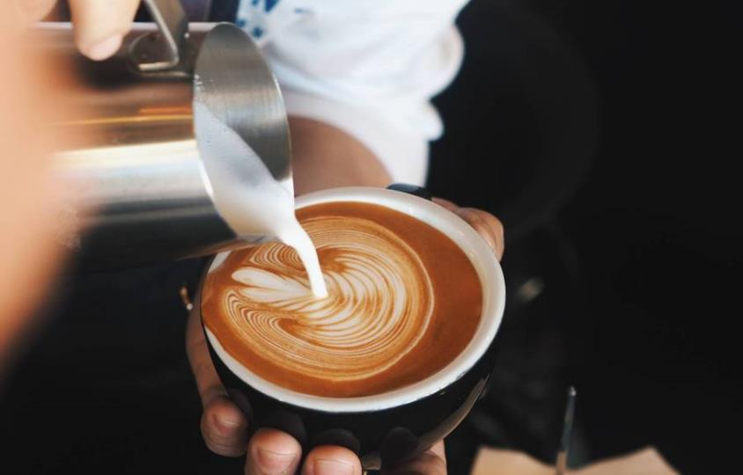

Main Page
Big screen

Slide 6

Menu Page

Slide 7

Video Page

Slide 8

Newsletter

Slide 9

Phone Version

Slide 10

Second Design

Slide 11
Timeline
31/08/2022
Start of project
13/09/2022
21/09/2022
Review of Design Iteration 2
6/10/2022
27/10/2022
Finished the website
Design choice was made by the client
Review of Design Iteration 1

Slide 12
Additional content
Java
PHP
PDF is downloaded using jQuery/JS
All pages are included with PHP and the navbar is done using the Get parameter
Newsletter has is validated using PHP

Slide 13

Thank you
Bernardo Alves
bernardo.correia.alves@student.nhlstenden.com

